Slide 1
MACHINE LEARNING — UNIT 5
Neural Network
Learning Rules
Presented By:
Siddhartha Shakya
Department of Computer Science & AI | Academic Lecture Series

Slide 2
Topics at a Glance
01
02
Hebbian Learning
Backpropagation
Unsupervised weight update rule inspired by neuroplasticity — neurons that fire together, wire together.
Supervised multi-layer training algorithm using gradient descent to minimize prediction error.
All three are foundational learning paradigms for training Artificial Neural Networks (ANNs)

Slide 3
01
Hebbian Learning
"Neurons that fire together, wire together" — Donald Hebb, 1949
Unsupervised Learning Algorithm

Slide 4
Hebbian Learning — Core Concept
What is Hebbian Learning?
Hebbian Neuron Model
Developed by Donald Hebb in 1949
An unsupervised weight-update algorithm
Inspired by biological synapse strengthening
“States that the synaptic efficacy between two neurons should increase if the neurons are simultaneously active and decrease if not.”
w1
x₁
x₂
w2
Σ
y
x₃
w3
bias
Hebbian Update Rule
wᵢ(new) = wᵢ(old) + xᵢ · y
b(new) = b(old) + y
xᵢ = input | wᵢ = weight | y = output (= target)

Slide 5
Hebbian Learning — Algorithm
STEP 1
Initialize
STEP 2
Set Inputs
Set all weights wᵢ = 0 for i = 1 to n
Set bias b = 0
For each training pair (S, t):
Activate input units: Xᵢ = Sᵢ for i = 1 to n
STEP 3
Set Output
STEP 4
Update Weights
Set the output neuron's activation to the target value:
y = t
Apply Hebb rule for all i = 1 to n:
wᵢ(new) = wᵢ(old) + xᵢ · y
b(new) = b(old) + y

Slide 6
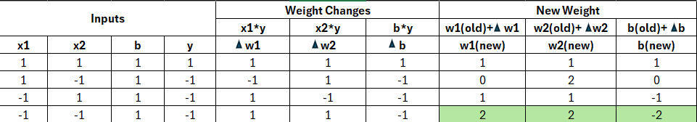
Hebbian Learning — Example: AND Function
Constructa Hebb Net which performs like an AND function. Use bipolar inputs and targets
Final Weights: w₁ = 2, w₂ = 2, b = -2
Y= b + x1 * w1 + x2 * w2
For tp (1,1) : Y= -2+(1*2)+(1*2) = 2 > 0 (So AND gate verified)

Slide 7
02
Backpropagation Learning
"Train multi-layer networks by propagating error backward through layers"
Supervised Learning with Gradient Descent

Slide 8
Backpropagation — Architecture & Concept
Key Concepts
Network Architecture
Trains a multilayer feed-forward neural network
Architecture: Input → Hidden → Output layers
Forward pass: computes predictions layer by layer
Backward pass: propagates error to update all weights
Uses gradient descent with a learning rate (l)
Sigmoid activation: O = 1 / (1 + e⁻ᴵ)
→ FORWARD
← BACKWARD
→ Forward Pass
Compute outputs
Propagate & update weights
Input Layer
Hidden Layer
Output Layer
← Backward Pass

Slide 9
Backpropagation — Key Formulas
FORWARD PASS
BACKWARD PASS
Net input (layer j):
Error — Output layer:
Iⱼ = Σᵢ wᵢⱼ · Oᵢ + θⱼ
Errⱼ = Oⱼ(1 − Oⱼ)(Tⱼ − Oⱼ)
Output (sigmoid):
Error — Hidden layer:
Oⱼ = 1 / (1 + e^(-Iⱼ))
Errⱼ = Oⱼ(1 − Oⱼ) Σₖ Errₖ wⱼₖ
Weight update:
Δwᵢⱼ = l · Errⱼ · Oᵢ → wᵢⱼ += Δwᵢⱼ
Bias update:
Δθⱼ = l · Errⱼ → θⱼ += Δθⱼ

Slide 10
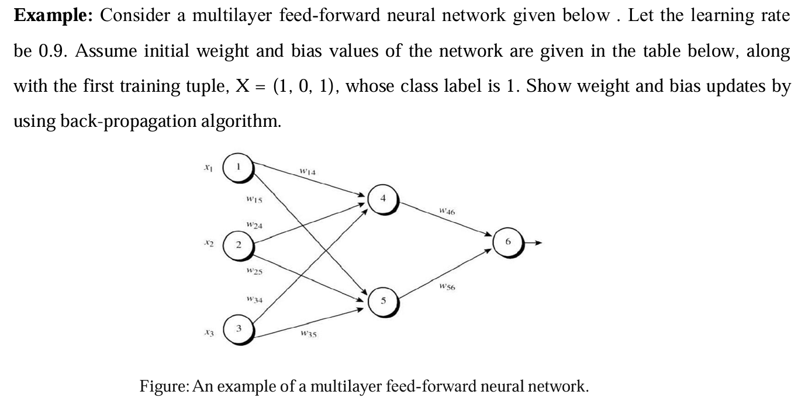
Backpropagation — Example 1

Slide 11
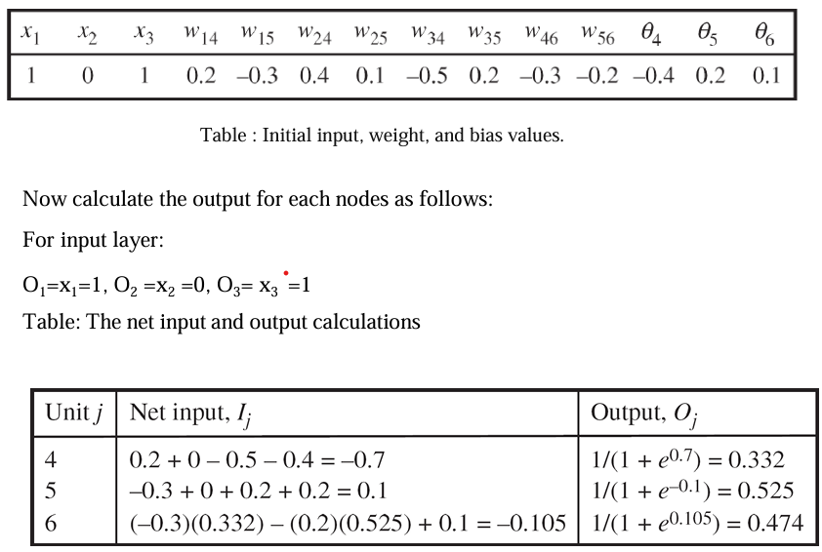
Backpropagation — Worked Example

Slide 12
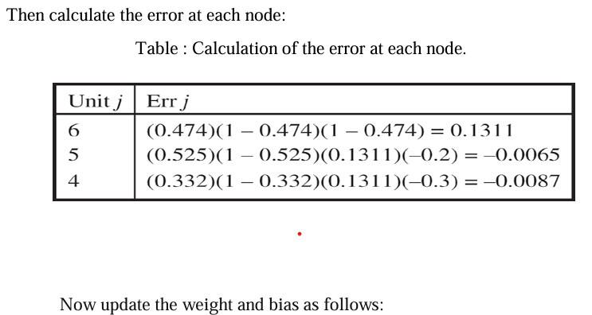
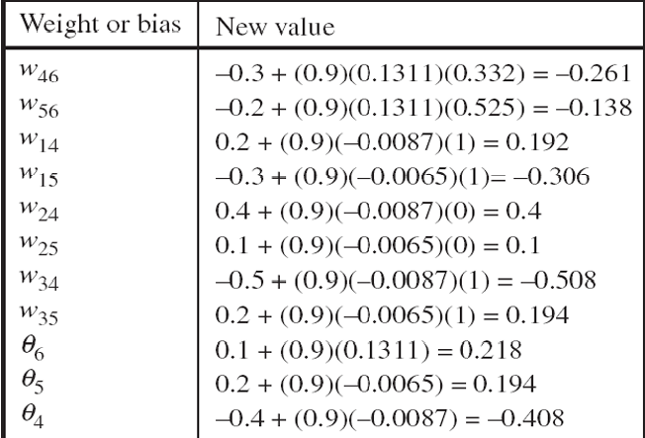
Backpropagation — Worked Example

Slide 13
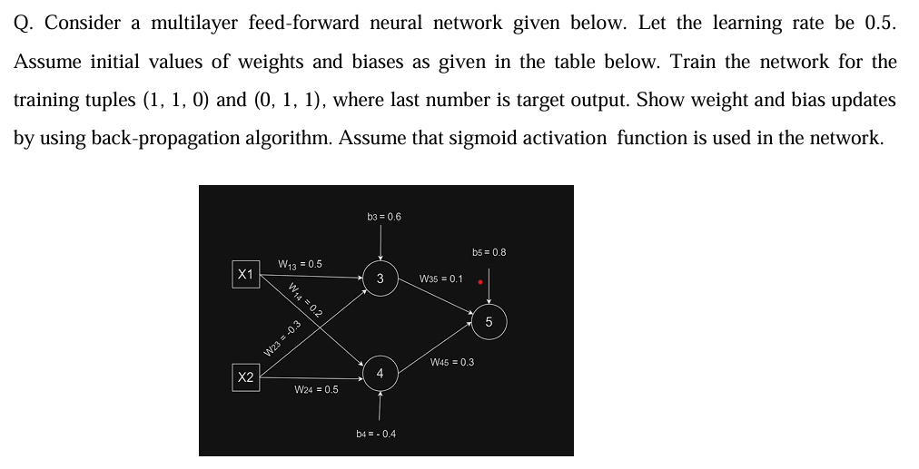
Backpropagation — Example 2

Slide 14
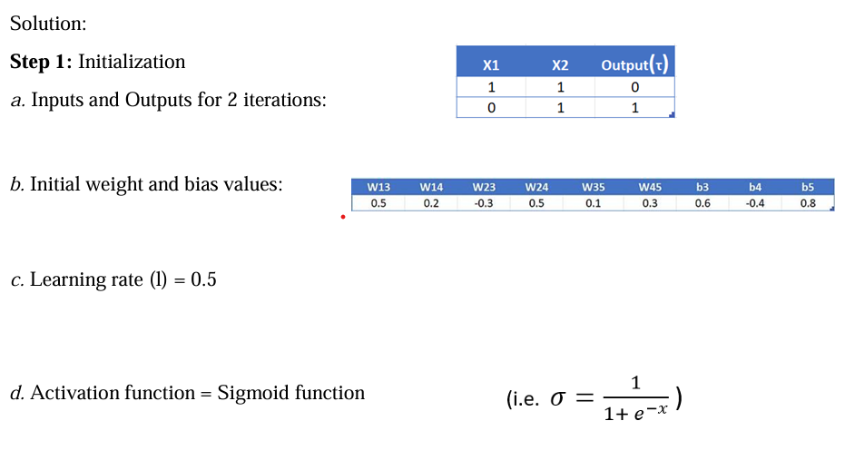
Backpropagation — Worked Example (Step 1)

Slide 15
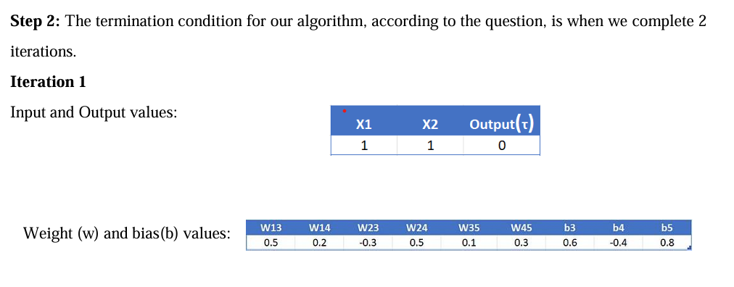
Backpropagation — Worked Example (Step 2)

Slide 16
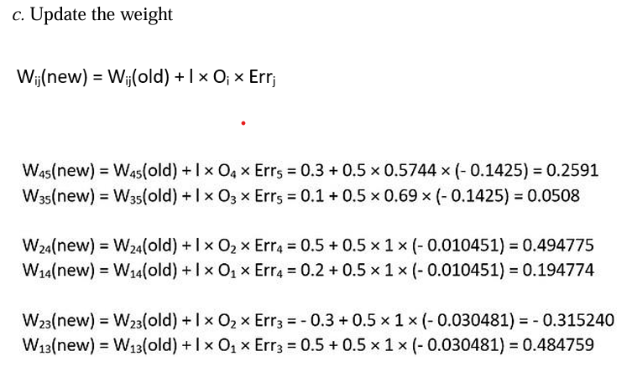
Backpropagation — Worked Example

Slide 17
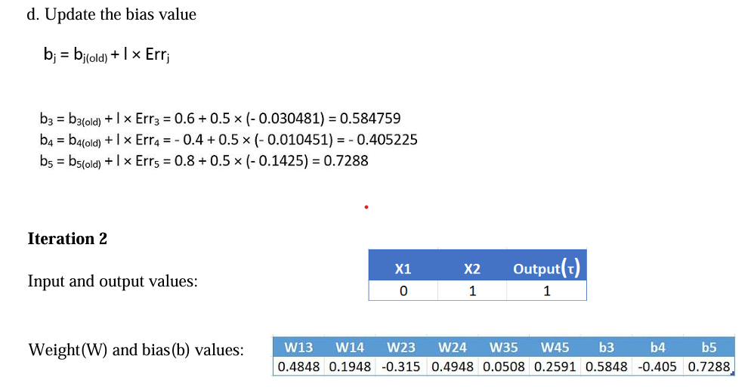
Backpropagation — Worked Example

Slide 18
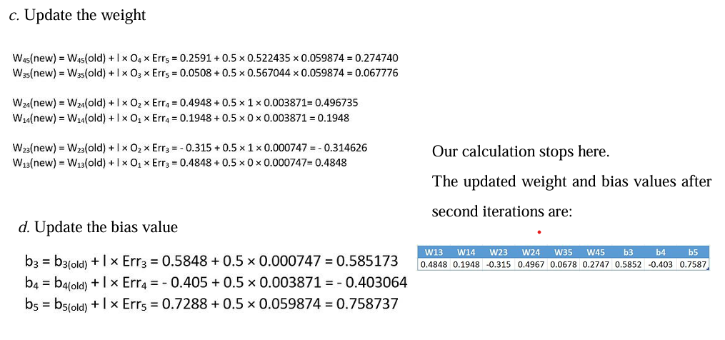
Backpropagation — Worked Example

